Slide 1

Stock management for grocery store
Name : Aarthi S
Roll No : ECA2301
REG NO : 8115U23EC001
Department : Electronics and
Communication Engineering
Semester : 2nd semester

Slide 2
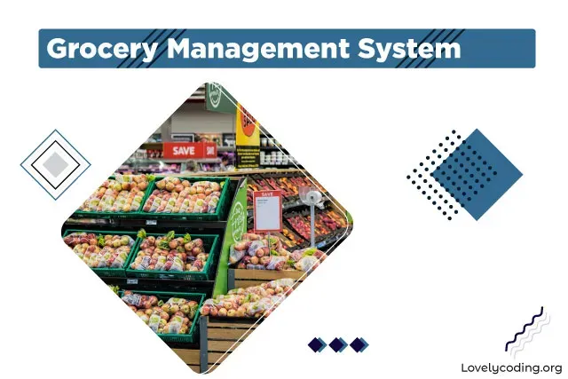
CONTENT:
INTRODUCTION
DATASTRUCTURES USED
WORKFLOW
MODULE COMPLETION
PROS AND CONS

Slide 3
INTRODUCTION
The purpose of Grocery shop management system is to automate the existing manual system by the help of computerized equipments and full-fledged computer software.
The use of C made it possible to create effective algorithms and data structures creating that is simple to use and efficient.
You can also modify or remove any product in this application
Buyer can search any items using item code.

Slide 4
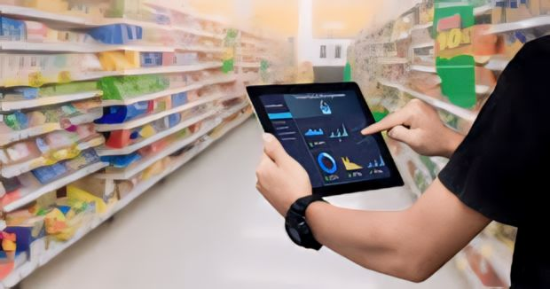
Datastructures used:
THE DATA STRUCTURE USED IN THIS STOCK MANAGEMENT FOR GROCERY STORE IS ARRAY IN STRUCTS, STACK .
EACH ELEMENT OF THE ARRAY CORRESPONDS TO BOTH ITS NAME AND QUANTITY WITHIN A SINGLE DATA STRUCTURE, SIMPLIFYING ACCESS AND MANIPULATION OF THE STORE’S INVENTORY.

Slide 5
WORK FLOW
SUPPLIER
RECEIVING ORDER
STORING
PAYMENTS
STOCK
AVAILABILITY
STOCK
NO
YES
CREATIVE INVOICE
CUSTOMER

Slide 6
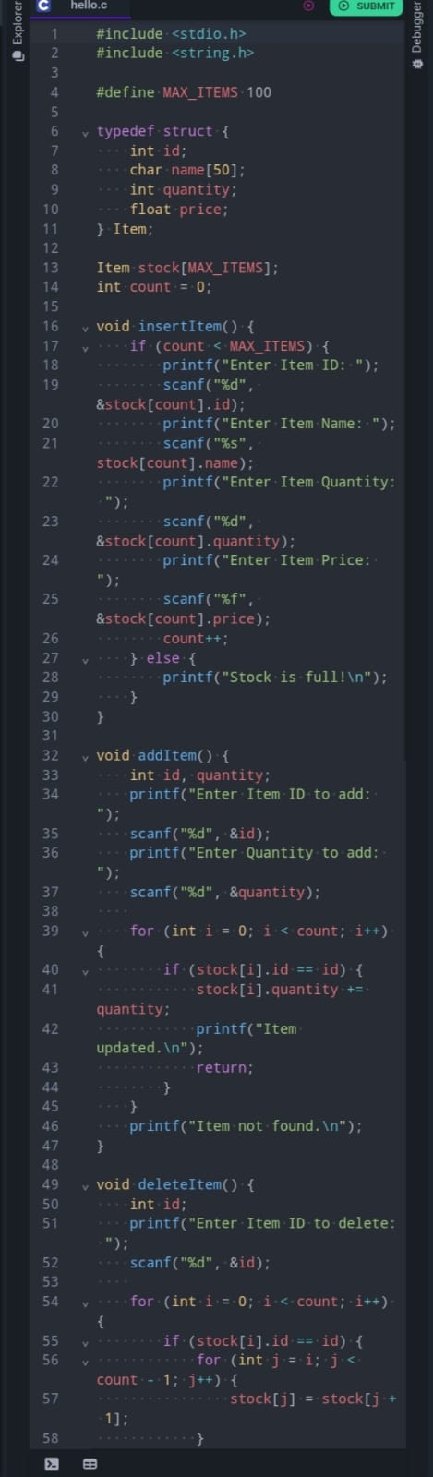
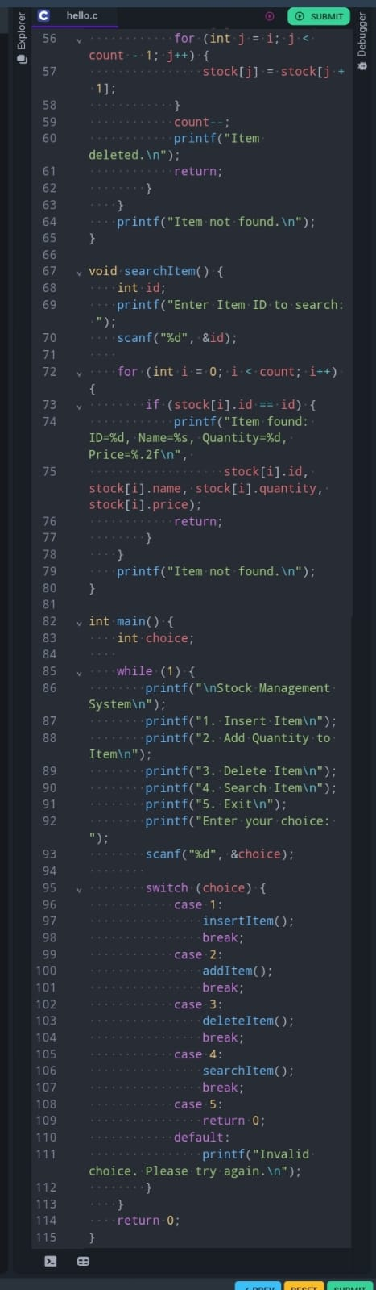
PROGRAM

Slide 7
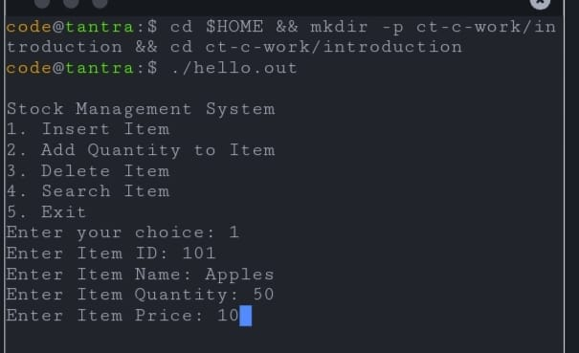
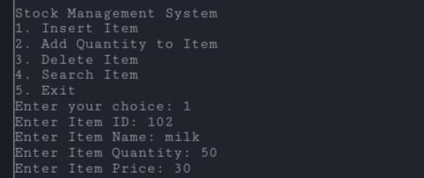
OUTPUT

Slide 8
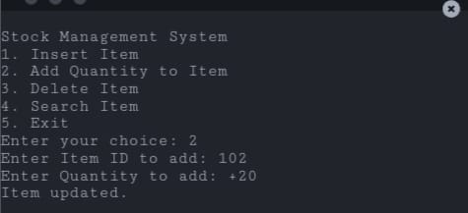
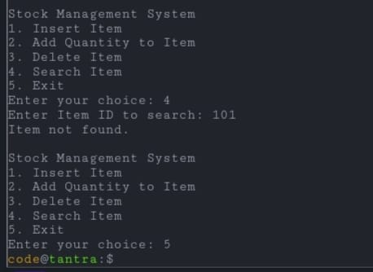
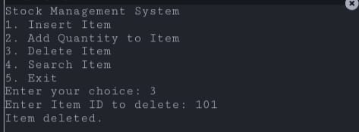

Slide 9
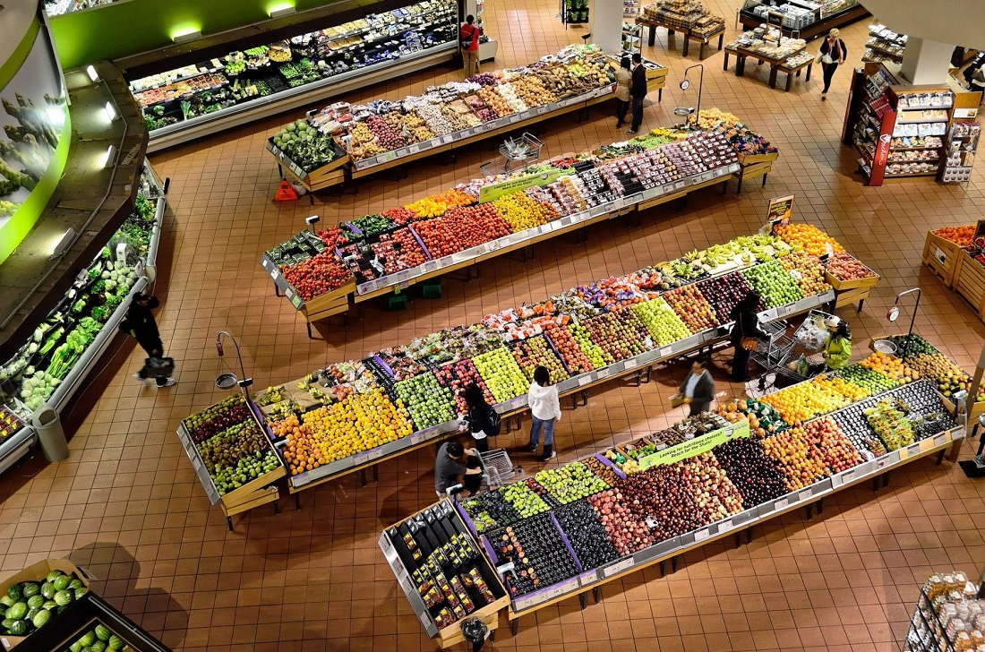
MODULE COMpLETION :
1. Product Module: This module defines structures or classes to represent products, including attributes like name, price, quantity, and expiration date. It also includes functions for adding, updating, and deleting products.
2. Inventory Module: This module manages the inventory, including functions to add stock, remove stock (for sales or wastage), and check stock levels. It may also include functions for tracking expiration dates and managing perishable items.
3. Order Module: This module handles orders from suppliers, including functions to place orders, receive shipments, update stock levels upon receipt of orders, and manage supplier information.
4. Sales Module: This module tracks sales transactions, including functions to record sales, update stock levels after each sale, generate receipts or invoices, and calculate revenue.
5. Reporting Module: This module generates reports and analytics based on stock data, sales data, and other relevant information. Functions may include generating inventory reports, sales reports, and analyses of stock turnover rates.

Slide 10



PROS & CONS
The benefits of Just In Case inventory management include preparedness for unexpected demand fluctuations and protection against supply chain disruptions.
However, drawbacks include higher storage costs, tied up capital and the risk of inventory obsolescence.

Slide 11
“thank you all for your time, attention and valuable contributions. Your presence made this presentation truly special”. - Aarthi s

